Slide 1
Income Prediction Report
Author: Nabarko Roy

Slide 2
Agenda
Problem Statement
High Level Solution Design
Solution Process – Building the Model
Data Analysis
Feature Engineering
Feature Selection
Model Selection
Solution Process – Deploy the Model

Slide 3


Problem Statement
Predict the income of an employee based on their different attributes
Business Stakeholders
The prediction task is to determine whether a person makes over $50K a year or not i.e., there are only 2 categories ($50K, <=$50K per year) on which each employee will be classified
Business Analysts/
Product Owners
Binary Classification problem to predict the income categories
Data Scientists

Slide 4


Solution Design – High Level
Re-calibration on Features & Algorithms
Build
Datasources
Not Satisfied
Data Analysis
Feature Engg
Feature Selection
Model Selection
Tracking Server
IF
Satisfied
Deploy
Yes
Drift
Model Monitoring
Model Serving
Packaging & Containerization
Explanations
BI Reports

Slide 5




Solution Process – Build
Income Data Records
Data Analysis
Feature Engg
Feature Selection
AutoML - Model Selection
Top Ranking Model

Slide 6
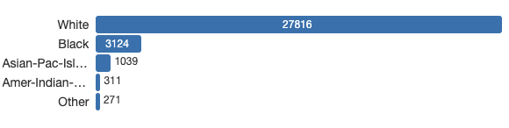
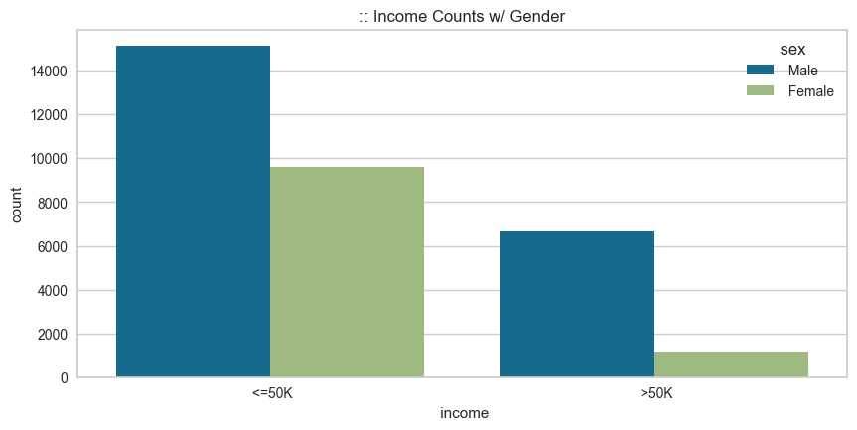
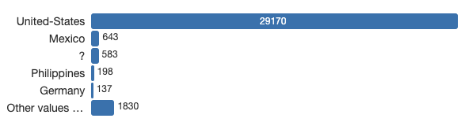
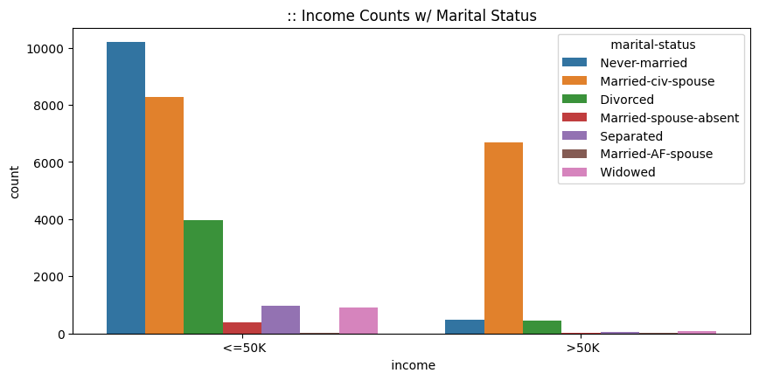
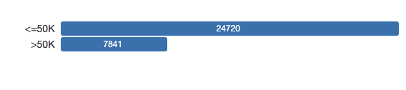
Data Analysis
Detailed Analysis report can be obtained from:
Income_Profile.html
Race is Imbalance in nature
Income of Males Tend be higher compared to Females
Native-Country is Imbalance in nature
Income is Imbalance in nature, target is imbalanced
Too many marital status categories, needs discretization

Slide 7
Feature Engineering
There are no default NaN values in the dataset. They are in present in manner of “?”, hence needed to be removed.
Many blank spaces are there before and after string values in the dataset, hence needed to clean them up and change all to lower cases.
Re-Organizing the Marital-Status Column to fewer categories.
Encoding the String or categorical variables using Label Encoder.

Slide 8
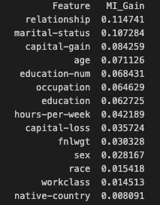
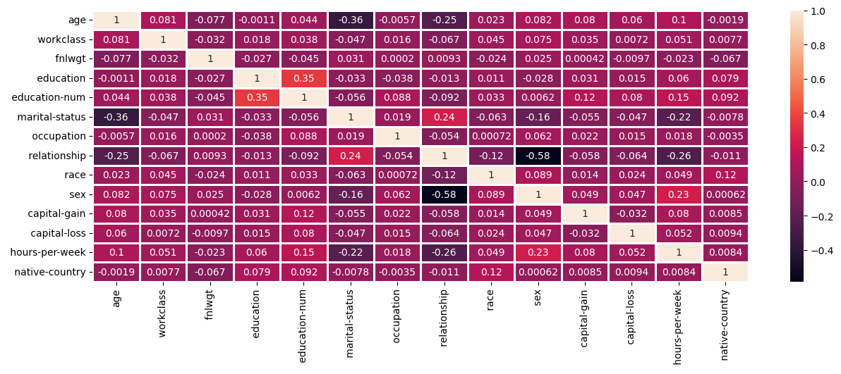
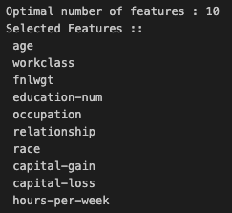
Feature Selection
Information Gain Assessment
Final List of Selected Variables:
Correlation Assessment
Information Gain Assessment
Recursive Feature Elimination using a base classifier
' relationship',
' marital-status',
' capital-gain',
'age',
' education-num',
' occupation',
'hours-per-week',
'fnlwgt'
Correlation Assessment
Recursive Feature Elimination using a base classifier

Slide 9

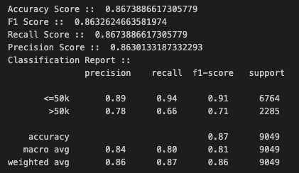

Model Selection
Pycaret :: open-source, low-code machine learning library in python that automates machine learning workflows.
Selected Features
Top ranking algorithms
LGBM
Vanila GBM
ADABoost
Selected Algorithm for Evaluation
Test/Validation Set Results:
Target Value :: Income
F1 score

Slide 10







Solution Process – Deploy*
Trained Model
Package Manager
Batch CSV o/p
Live Data Lake/Source
Process Data
BI Reports
Open Downstream API
*Probable Future

Slide 11
Summary
In this presentation, we tried to understand the problem statement & how we can break it down the technical statement
Create a design blueprint from start to the end of the pipeline, defining each step.
Zoomed in on the Build process & what tools were applied to reach the end of model building stage.
Got a very high-level overview on how the possible deployment can be done, and this process can be followed for any ML problem.

Slide 12
Thank You

